Slide 1


Slide 2
K-MEANS

Slide 3


Clustering is a set of techniques used to partition data into groups, or clusters. Clusters are loosely defined as groups of data objects that are more similar to other objects in their cluster than they are to data objects in other clusters.

Slide 4
For our dataset we are going to use a weather dataset...
As with the daily weather data, this data comes from a weather station located in San Diego, California. The weather station is equipped with sensors that capture weather-related measurements such as air temperature, air pressure, and relative humidity. Data was collected for a period of three years, from September 2011 to September 2014, to ensure that sufficient data for different seasons and weather conditions is captured.

Slide 5
First we will introduce the dataset attributes for you which are :
rowID: unique number for each row (Unit: NA)
hpwren_timestamp: timestamp of measure (Unit: year-month-day hour:minute:second)
air_pressure: air pressure measured at the timestamp (Unit: hectopascals)
air_temp: air temperature measure at the timestamp (Unit: degrees Fahrenheit)
avg_wind_direction: wind direction averaged over the minute before the timestamp (Unit: degrees, with 0 means coming from the North, and increasing clockwise)
avg_wind_speed: wind speed averaged over the minute before the timestamp (Unit: meters per second)

Slide 6
max_wind_direction: highest wind direction in the minute before the timestamp (Unit: degrees, with 0 being North and increasing clockwise)
max_wind_speed: highest wind speed in the minute before the timestamp (Unit: meters per second)
min_wind_direction: smallest wind direction in the minute before the timestamp (Unit: degrees, with 0 being North and inceasing clockwise)
min_wind_speed: smallest wind speed in the minute before the timestamp (Unit: meters per second)
rain_accumulation: amount of accumulated rain measured at the timestamp (Unit: millimeters)
rain_duration: length of time rain has fallen as measured at the timestamp (Unit: seconds)
relative_humidity: relative humidity measured at the timestamp (Unit: percent)

Slide 7
As usual we will start by importing the required libraries that we are going to use
import pandas as pd import numpy as np import seaborn as snb import matplotlib.pyplot as plt from sklearn.preprocessing import StandardScaler from sklearn.cluster import KMeans %matplotlib inline

Slide 8
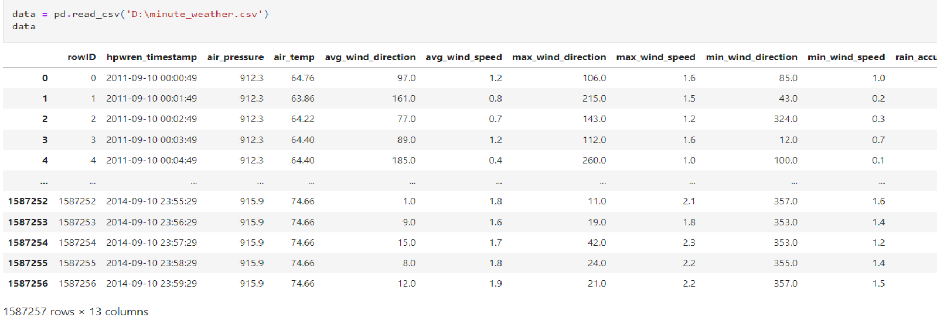
We will start out by reading our data

Slide 9
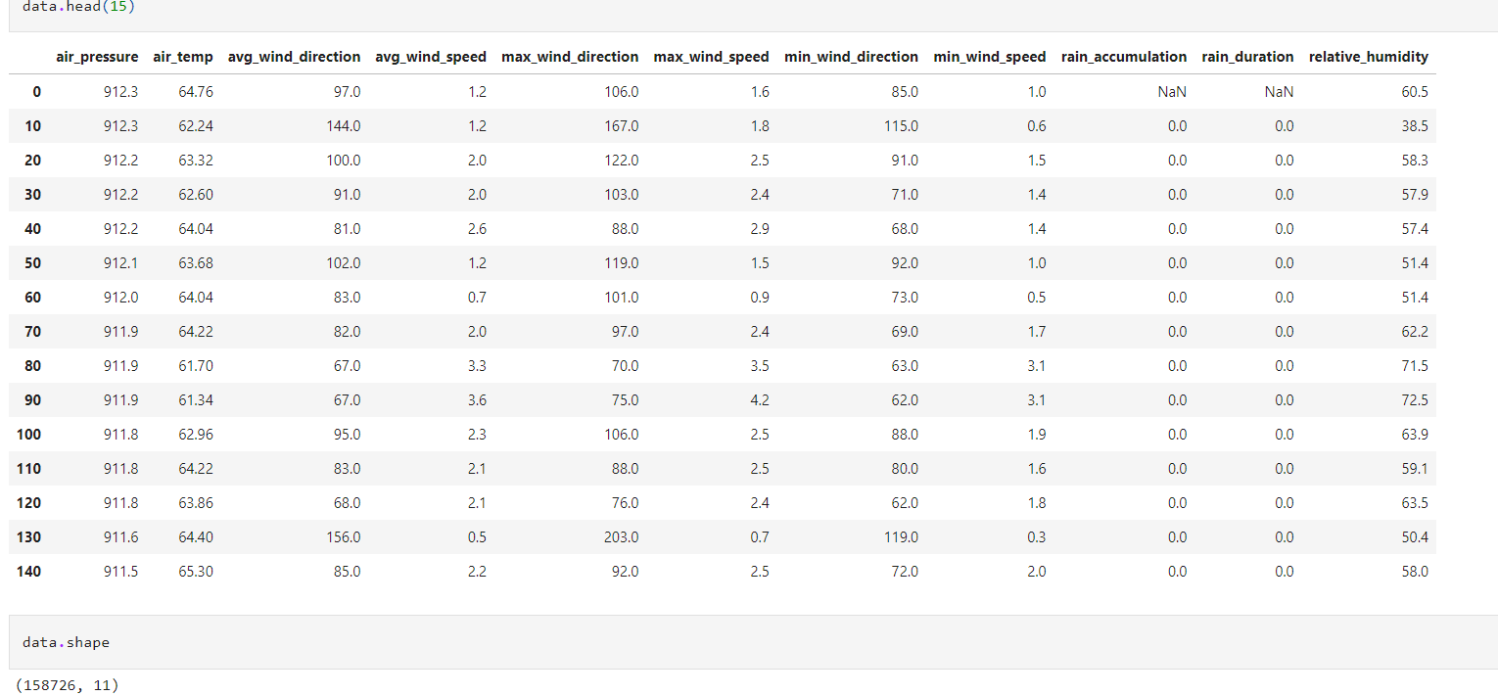
Since our data is enormous we will have to remove some of it
We will get forward by sampling our data we are taking every 10th row from the table

Slide 10
After wards we are going to check for the duplicates using the function data.duplicated().sum() .
Since we have huge data there were 3252 duplicates so we are going to remove them using the function data.drop_duplicates() .
After checking for the duplicates sum again it turns out that the sum is equal to zero and we are good to go and statr searching for the outliers .

Slide 11
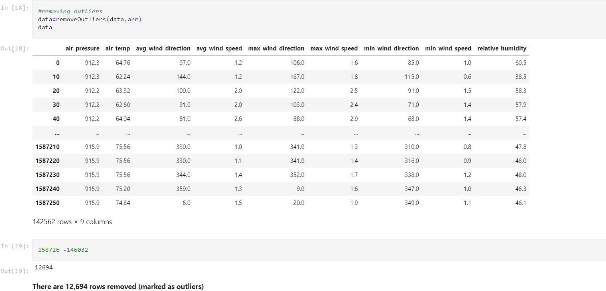
We will make a function named "detectoutliers" to find the outliers in each attribute in our data and we are going to represent it using box plots .
From the box plot we determine that we are going to remove outliers from rain_duration and rain_accumulation columns since they contain noisy data.

Slide 12
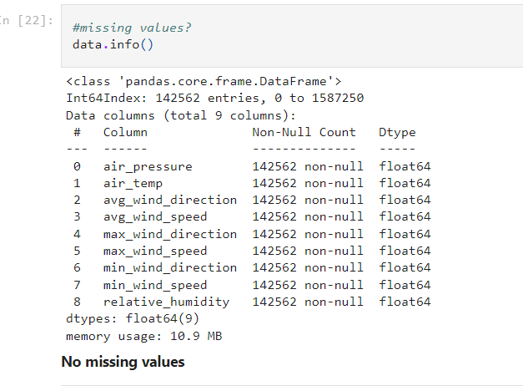
After that we are going to check for any missing values so that we can handle them

Slide 13
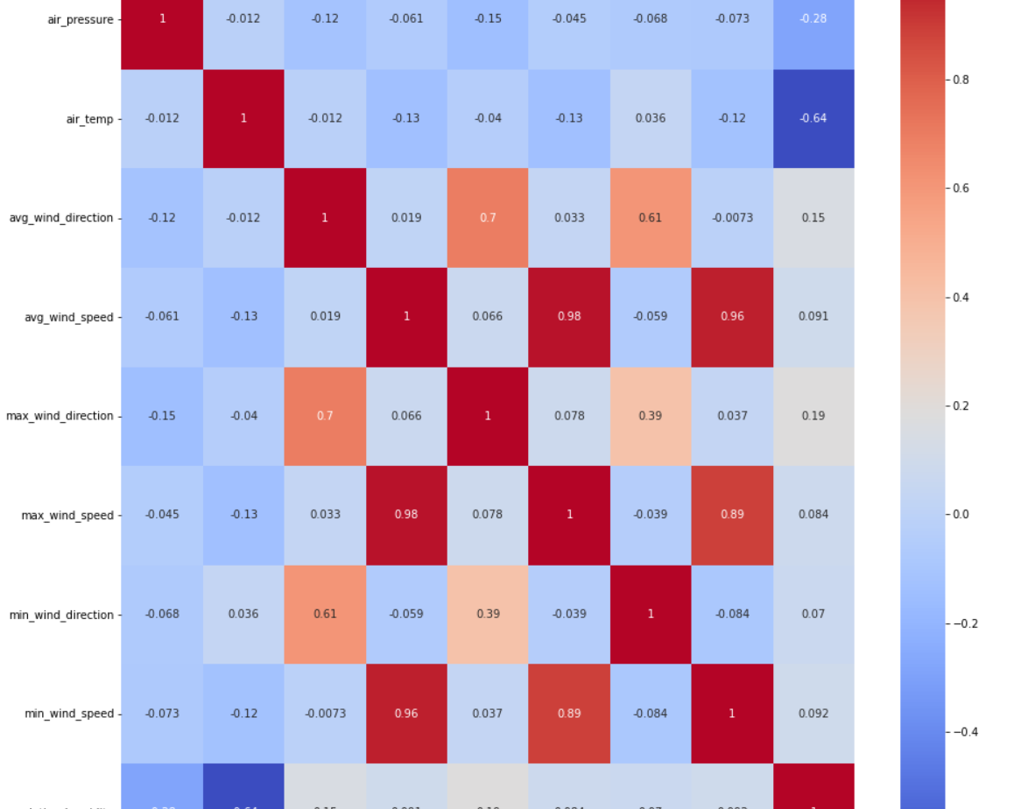
Good we have no missing values that means we can move forward to correlation matrix

Slide 14
There are attributes with correlation more than 0.8 ,needs to be dropped which are max_wind_speed and min_wind_speed
We are going to use avg_wind_speed in our algorithm
Scale the Features using StandardScaler (normalize data before applying Kmeans)
After that we will proceed to using k-means
We will choose number of clusters which will be equal to 12
Then we will calculate the centers of the 12 cluster we choose at first

Slide 15
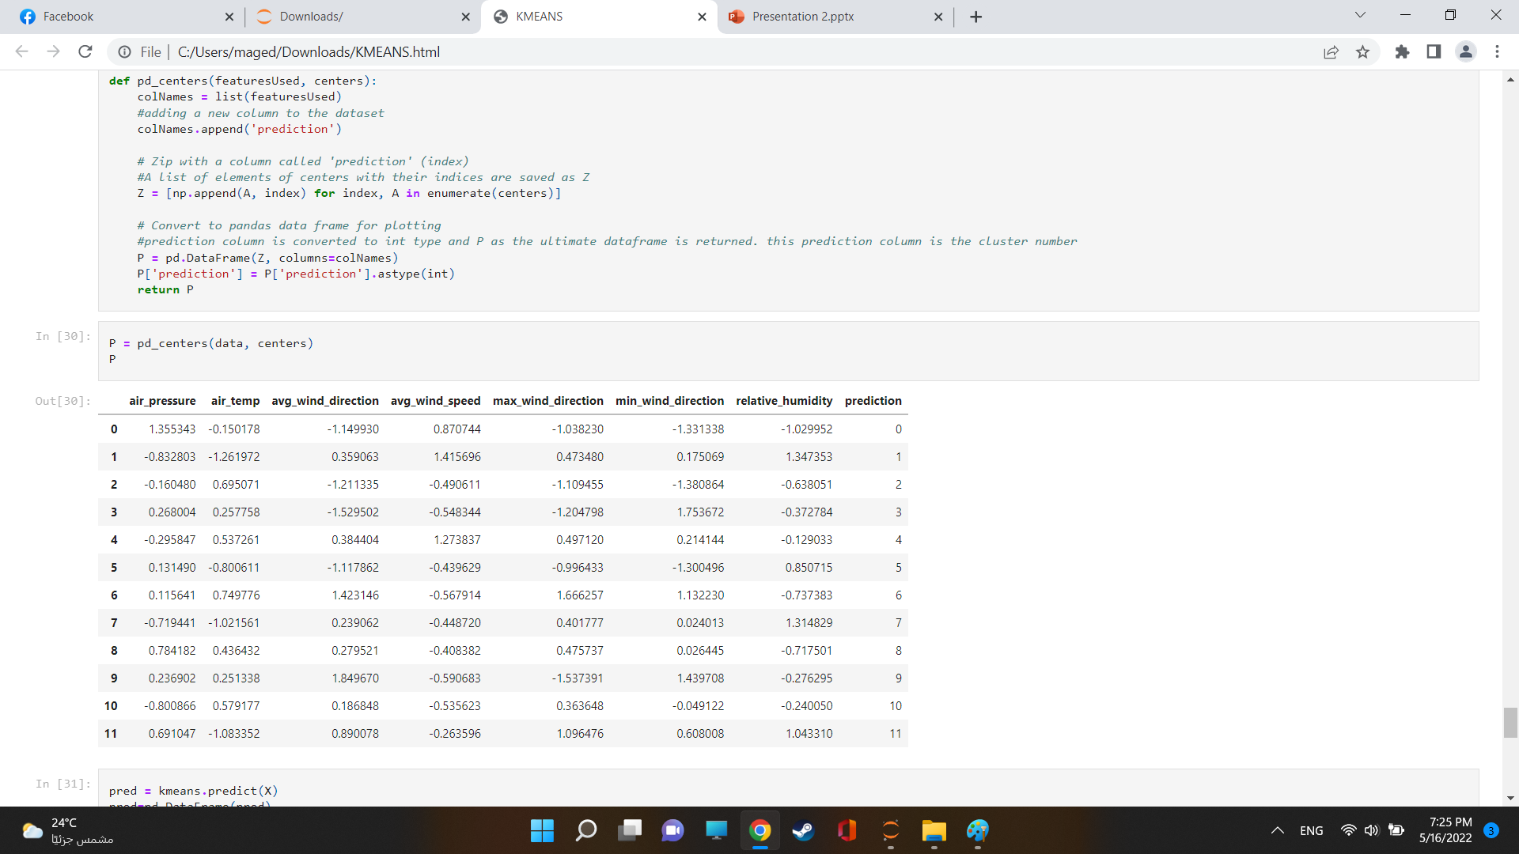
Function that creates a DataFrame with a column for Cluster Number

Slide 16
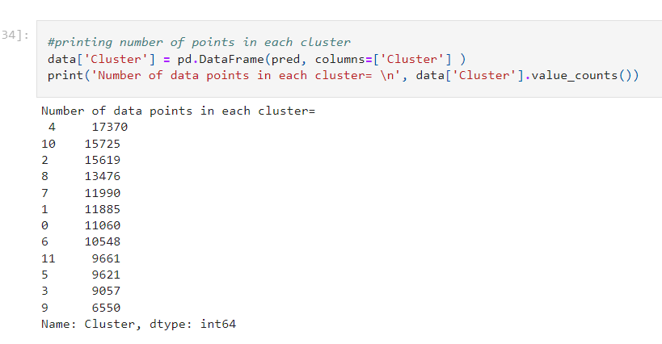
For the final step we will print the number of points in each cluster

Slide 17
As shown it turns out that:
The first cluster has 11060 points
The second cluster has 11885 points
The third cluster has 15619 points
The fourth cluster has 9057 points
The fifth cluster has 17370 points (THE HIGHEST)
…... so on
And that the tenth cluster has 6550 points (THE LOWEST)

